Slide 1
Networking in the Cloud

Slide 2
Understanding and application of routing protocols, routed protocols, application layer protocols

Slide 3
What is routing?
Routing is the process of path selection in any network. A computer network is made of many machines, called nodes, and paths or links that connect those nodes. Communication between two nodes in an interconnected network can take place through many different paths. Routing is the process of selecting the best path using some predetermined rules.

Slide 4
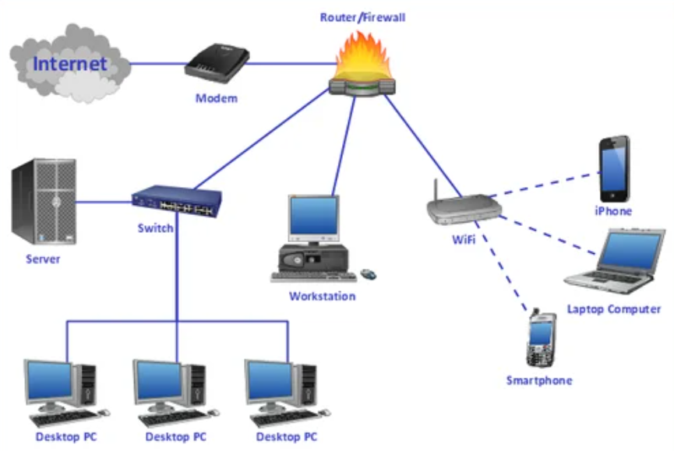

Slide 5
Why is routing important?
Routing creates efficiency in network communication. Network communication failures result in long wait times for website pages to load for users. It can also cause website servers to crash because they can't handle a large number of users. Routing helps minimize network failure by managing data traffic so that a network can use as much of its capacity as possible without creating congestion.

Slide 6
What is a router?
A router is a networking device that connects computing devices and networks to other networks. Routers primarily serve three main functions.
Path determination
A router determines the path data takes when it moves from a source to a destination. It tries to find the best path by analyzing network metrics such as delay, capacity, and speed.

Slide 7
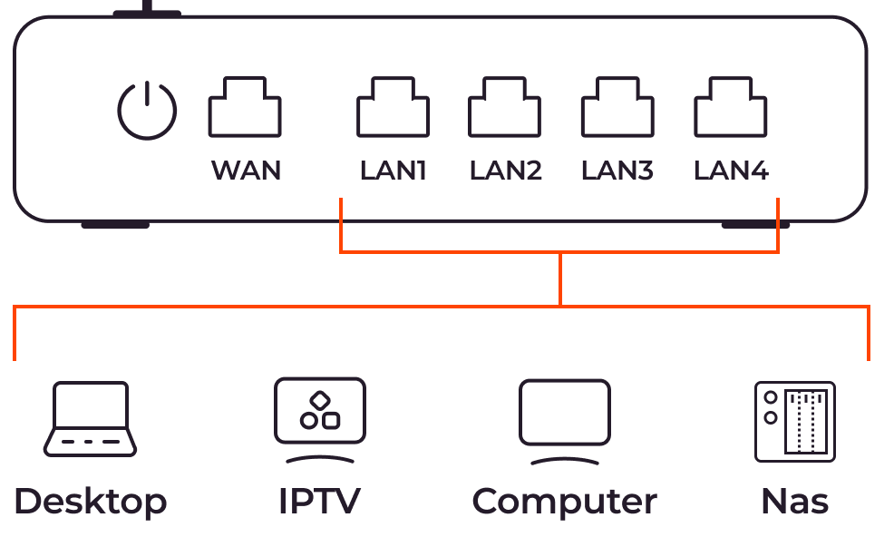

Slide 8
Data forwarding
A router forwards data to the next device on the selected path to eventually reach its destination. The device and router may be on the same network or on different networks.
Load balancing
Sometimes the router may send copies of the same data packet by using multiple different paths. It does this to reduce errors due to data losses, create redundancy, and manage traffic volume.

Slide 9
How does routing work?
Data moves along any network in the form of data packets. Each data packet has a header that contains information about the packet’s intended destination. As a packet travels to its destination, several routers might route it multiple times. Routers perform this process millions of times each second with millions of packets.
When a data packet arrives, the router first looks up its address in a routing table. This is similar to a passenger consulting a bus timetable to find the best bus route to their destination. Then the router forwards or moves the packet onward to the next point in the network.

Slide 10
How does routing work?
For example, when you visit a website from a computer in your office network, data packets first go to the office network router. The router looks up the header packet and determines the packet destination. It then looks up its internal table and forwards the packet—either to the next router or to another device, such as a printer—within the network itself.

Slide 11
What are the types of routing?
There are two different types of routing, which are based on how the router creates its routing tables:
Static routing
In static routing, a network administrator uses static tables to manually configure and select network routes. Static routing is helpful in situations where the network design or parameters are expected to remain constant.
The static nature of this routing technique comes with expected drawbacks, such as network congestion. While administrators can configure fallback paths in case a link fails, static routing generally decreases the adaptability and flexibility of networks, resulting in limited network performance.

Slide 12
What are the types of routing?
Dynamic routing
In dynamic routing, routers create and update routing tables at runtime based on actual network conditions. They attempt to find the fastest path from the source to the destination by using a dynamic routing protocol, which is a set of rules that create, maintain, and update the dynamic routing table.
The biggest advantage of dynamic routing is that it adapts to changing network conditions, including traffic volume, bandwidth, and network failure.

Slide 13
What are routing algorithms?
Routing algorithms are software programs that implement different routing protocols. They work by assigning a cost number to each link; the cost number is calculated using various network metrics. Every router tries to forward the data packet to the next best link with the lowest cost.

Slide 14
What are routing algorithms?
The following are some example algorithms.
Distance Vector Routing
The Distance Vector Routing algorithm requires all routers to periodically update each other about the best path information they have found. Each router sends information about the current assessment of the total cost to all known destinations.
Eventually, every router in the network discovers the best path information for all possible destinations.
Link State Routing
In Link State Routing, every router discovers all other routers in the network. Using this information, a router creates a map of the complete network and then calculates the shortest path for any data packet.

Slide 15
How has routing evolved?
Routing has evolved to meet the requirements of advances in network technology. Routing is no longer just about switching data packets between autonomous systems and the internet.
We now have cloud infrastructure with computing resources and hardware hosted by third-party cloud providers. These cloud resources are connected virtually to create a virtual network of resources that businesses can use to host and run applications. Many organizations now have hybrid networks that consist of both on-premises networks with internal hardware and cloud networks. Routers must route traffic between these internal networks, the internet, and the cloud.

Slide 16
What is cloud routing?
Cloud routing dynamically manages connections between two virtual cloud networks or between a cloud network and an on-premises network using the Border Gateway Protocol (BGP). Cloud routing adapts automatically to changing network conditions in the cloud. A cloud router—software that virtualizes the functions of a router—facilitates cloud routing.

Slide 17
What is DNS routing?
DNS, or the Domain Name System, translates human-readable domain names (for example, www.amazon.com) to machine-readable IP addresses (for example, 192.0.2.44). The data that maps this name information to machine information is stored separately on DNS servers. Before sending data to any website, routers must communicate with the DNS server to identify the exact machine address for the data packets.
DNS server communication can become a bottleneck, especially when many users want to visit a website at the same time. DNS routing refers to the various routing strategies and algorithms that manage communication with the DNS server. Various strategies, such as latency-based routing and geographic location–based routing, help manage the DNS server communication load.

Slide 18
Common network protocols and their functions
Without network protocols, the modern internet would cease to exist.
Network protocols enable the exchange of information across the internet and work behind the scenes so effectively that many users don't think twice about them or how the internet works. But it's critical for networking professionals to know and understand protocols as the foundation of networking

Slide 19
Common network protocols and their functions
It includes different types of network protocols, such as the following:
Communication protocols.
These include Address Resolution Protocol (ARP), Hypertext Transfer Protocol (HTTP), Internet Protocol (IP), Simple Mail Transfer Protocol (SMTP), Transport Control Protocol (TCP) and User Datagram Protocol (UDP).
Routing protocols.
These include Border Gateway Protocol (BGP) and Open Shortest Path First (OSPF).
Network management protocols.
These include Domain Name System (DNS), Dynamic Host Configuration Protocol (DHCP), File Transfer Protocol (FTP), Internet Control Message Protocol (ICMP), Simple Network Management Protocol (SNMP) and Telnet.

Slide 20
Address Resolution Protocol (ARP)
ARP translates IP addresses to MAC addresses and vice versa so LAN endpoints can communicate with one another. ARP is necessary because IP and MAC addresses are different lengths and operate on different layers of the OSI model. Below is a breakdown of the various address lengths:
IP version 4 (IPv4) addresses are 32 bits.
IPv6 addresses are 128 bits.
MAC addresses -- a device's physical hardware number -- are 12 hexadecimal digits split into six pairs.
These addresses must be translated for proper communication and data transfer among connected devices. ARP isn't required every time devices attempt to communicate because the LAN's host system maps and stores the translated addresses in its ARP cache. As a result, the ARP translation process is mainly used when new devices join the network.

Slide 21
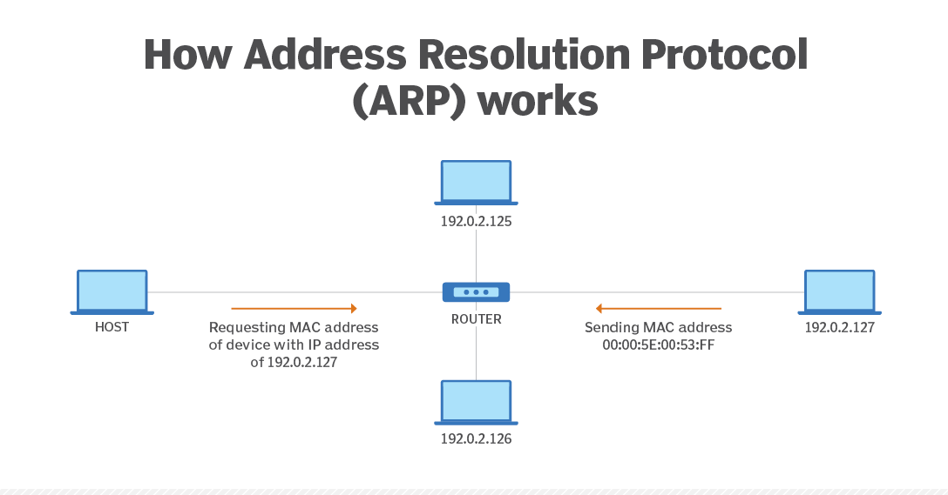

Slide 22
Border Gateway Protocol (BGP)
BGP makes the internet work. This routing protocol controls how packets pass through routers in an autonomous system (AS) -- one or multiple networks run by a single organization or provider -- and connect to different networks. BGP can connect endpoints on a LAN to one another, and it can connect endpoints in different LANs to one another over the internet.
External BGP directs network traffic from various ASes to the internet and vice versa. Internal BGP directs network traffic between endpoints within a single AS.

Slide 23
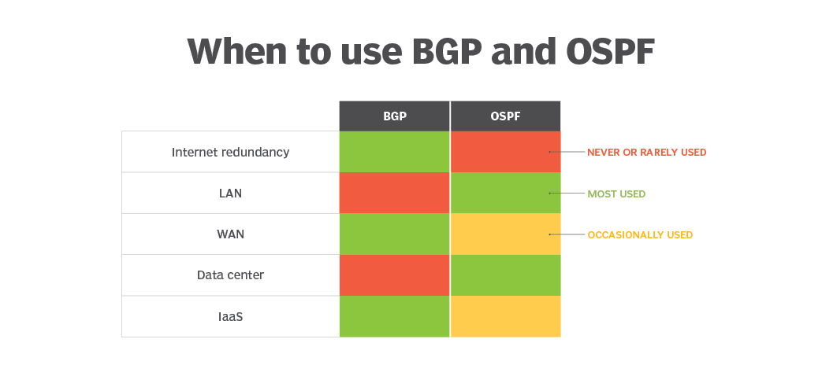

Slide 24
Domain name system (DNS)
DNS is an application layer protocol and acts as database that includes a website's domain name and its corresponding IP addresses. People use a domain name to access a website, while devices use an IP address to locate a website.
DNS translates the domain name into IP addresses, and these translations are included within DNS servers. Servers can cache DNS data, which is required to access the websites. DNS also includes the DNS protocol, which is within the IP suite and details the specifications DNS uses to translate and communicate.
DNS is important because it can provide users with information quickly and enable access to remote hosts and resources across the internet.

Slide 25
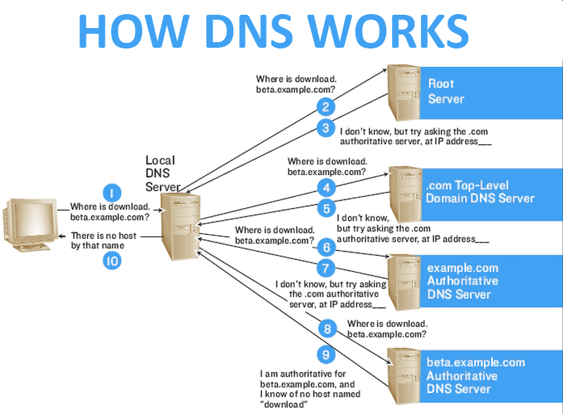

Slide 26
Dynamic Host Configuration Protocol (DHCP)
DHCP assigns IP addresses to network endpoints so they can communicate with other network devices over IP. Whenever a device joins a network with a DHCP server for the first time, DHCP automatically assigns it a new IP address and continues to do so each time a device moves locations on the network. Without DHCP, network administrators manually assign IP addresses to each new device.
When a device connects to a network, a DHCP handshake takes place. In this handshake process, the device and DHCP server communicate using the following steps:
The device establishes a connection.
The server receives the connection and provides available IP addresses.
The device requests an IP address.
The server confirms the address to complete the process.

Slide 27
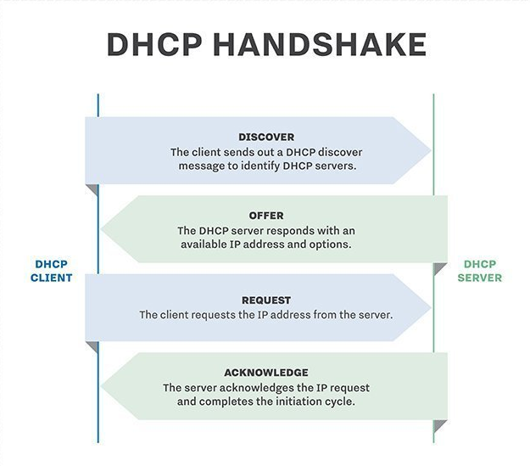

Slide 28
File Transfer Protocol (FTP)
FTP is a client-server protocol, with which a client requests a file and the server supplies it. FTP runs over TCP/IP -- a suite of communications protocols -- and requires a command channel and a data channel to communicate and exchange files, respectively. Clients request files through the command channel and receive access to download, edit and copy the file, among other actions, through the data channel.
FTP has grown less popular as most systems began to use HTTP for file sharing. However, FTP is a common network protocol for more private file sharing, such as in banking.

Slide 29
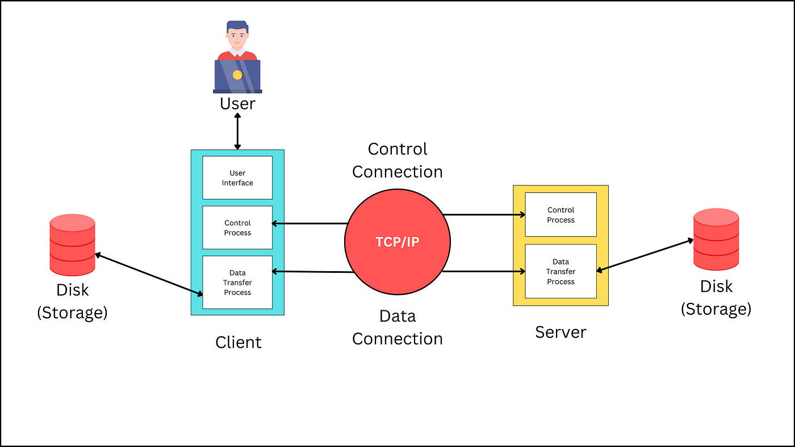

Slide 30
Hypertext Transfer Protocol (HTTP)
Like FTP, HTTP is a file sharing protocol that runs over TCP/IP. But HTTP primarily works over web browsers and is commonly recognizable for most users. When a user enters a website domain and aims to access it, HTTP provides the access. HTTP connects to the domain's server and requests the site's HTML, which is the code that structures and displays the page's design.
Another form of HTTP is HTTPS, which stands for HTTP over Secure Sockets Layer or HTTP Secure. HTTPS can encrypt a user's HTTP requests and webpages. This provides more security to users and can prevent common cybersecurity threats, such as man-in-the-middle attacks.

Slide 31
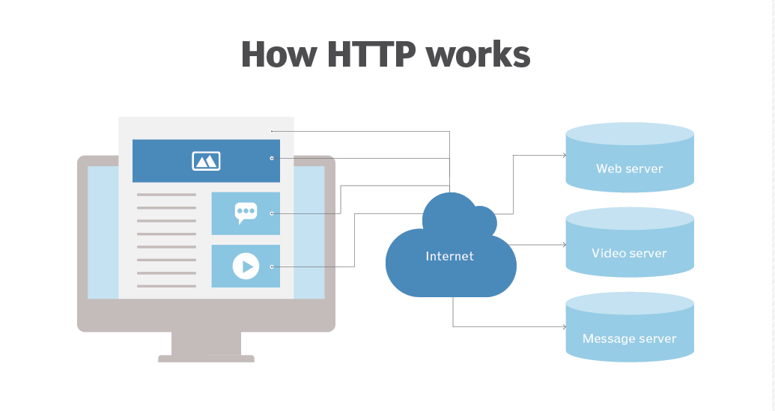

Slide 32
Internet Control Message Protocol (ICMP)
ICMP is a network layer protocol used for error handling, diagnostics and control messages between network devices. It helps identify network connectivity issues and manage the flow of data packets. It does not transfer data.
Ping and traceroute both use ICMP to test connectivity and trace packet routes. Common ICMP messages include the following:
Echo Request and Echo Reply.
Destination Unreachable.
Time Exceeded.
Redirect Message.

Slide 33
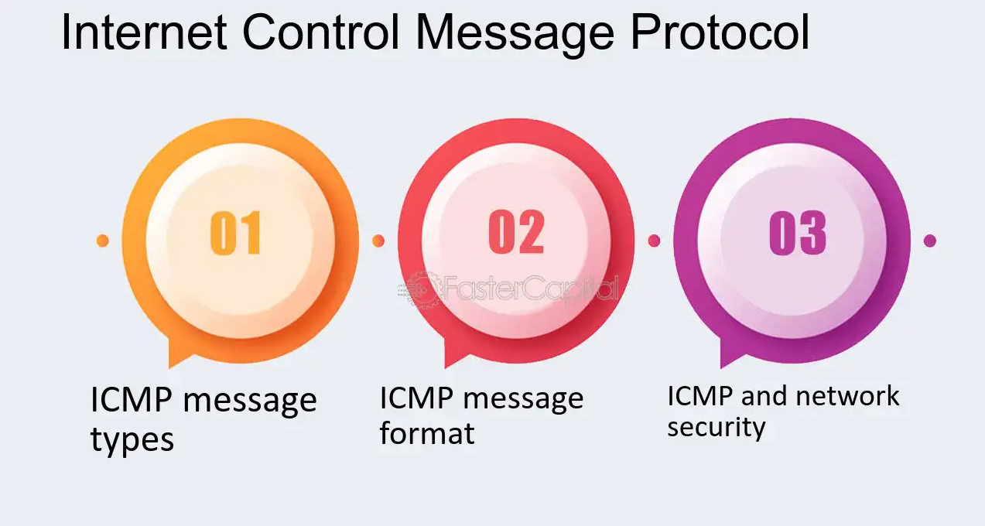

Slide 34
Internet Protocol (IP)
IP functions similarly to a postal service. When users send and receive data from their device, the data gets spliced into packets. Packets are like letters with two IP addresses: one for the sender and one for the recipient.
After the packet leaves the sender, it goes to a gateway, like a post office, that directs it in the proper direction. Packets continue to travel through gateways until they reach their destinations.
IP is commonly paired with TCP to form TCP/IP, the overall internet protocol suite. Together, IP sends packets to their destinations, and TCP arranges the packets in the correct order, as IP sometimes sends packets out of order to ensure the packets travel the fastest ways.

Slide 35
Open Shortest Path First (OSPF)
OSPF works with IP to send packets to their destinations. IP aims to send packets on the quickest route possible, which OSPF is designed to accomplish. OSPF opens the shortest, or quickest, path first for packets. It also updates routing tables -- a set of rules that control where packets travel -- and alerts routers of changes to the routing table or network when a change occurs.
OSPF is similar to and supports Routing Information Protocol, which directs traffic based on the number of hops it must take along a route, and it has also replaced RIP in many networks. OSPF was developed as a more streamlined and scalable alternative to RIP. For example, RIP sends updated routing tables out every 30 seconds, while OSPF sends updates only when necessary and makes updates to the particular part of the table where the change occurred.

Slide 36
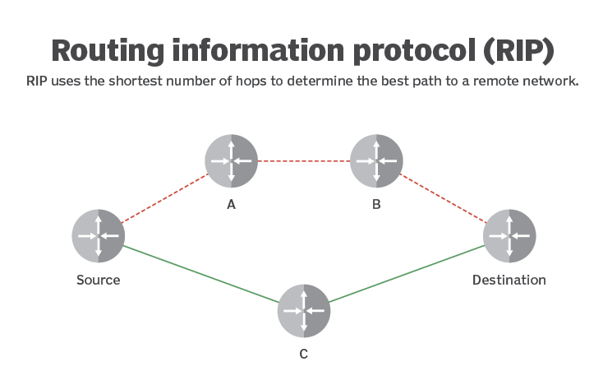

Slide 37
Simple Mail Transfer Protocol (SMTP)
SMTP is the most popular email protocol, is part of the TCP/IP suite and controls how email clients send users' email messages. Email servers use SMTP to send email messages from the client to the email server to the receiving email server. However, SMTP doesn't control how email clients receive messages -- just how clients send messages.
That said, SMTP requires other protocols to ensure email messages are sent and received properly. SMTP can work with Post Office Protocol 3 or Internet Message Access Protocol, which control how an email server receives email messages.

Slide 38
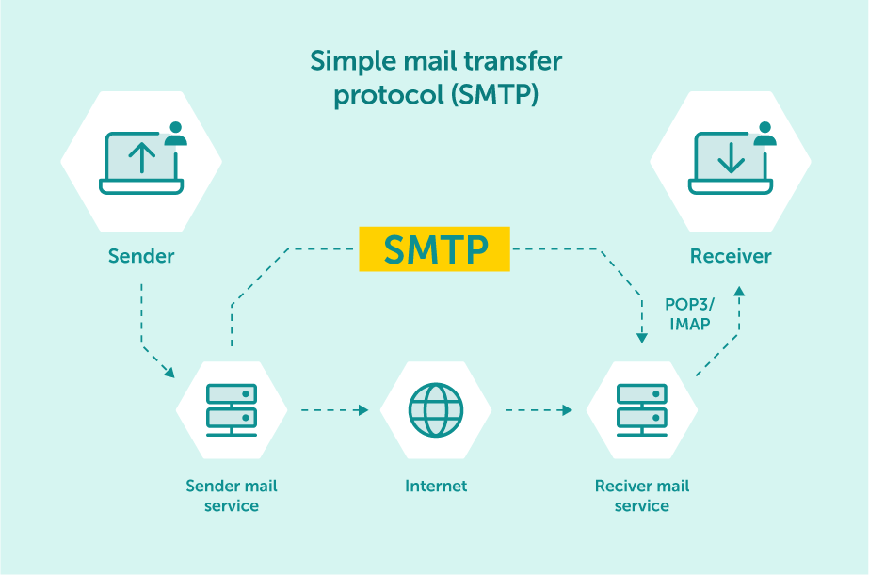

Slide 39
Simple Network Management Protocol (SNMP)
SNMP is a network management protocol that helps network admins manage and monitor network devices. It gathers device information to monitor network performance and health. Network administrators often use SNMP to detect and troubleshoot network issues.
SNMP uses a manager-agent model and uses the following components:
SNMP manager, which communicates with the agents and requests or updates information.
SNMP agent, which is installed on devices and sends information to the manager.
Management information base, which acts as a database and contains device information.

Slide 40
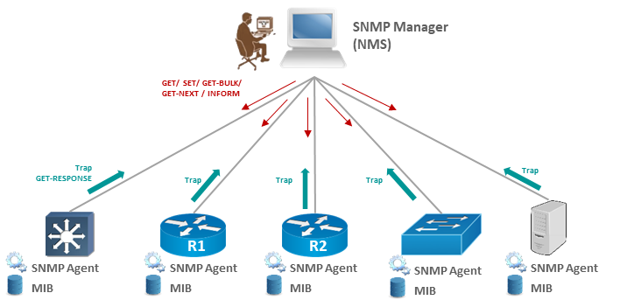

Slide 41
Telnet
Telnet is designed for remote connectivity, and it establishes connections between a remote endpoint and a host machine to enable a remote session. Telnet prompts the user at the remote endpoint to log on. Once the user is authenticated, Telnet gives the endpoint access to network resources and data at the host computer.
Telnet has existed since the 1960s and was arguably the first draft of the modern internet. However, Telnet lacks sophisticated security protections required for modern communications and technology, so it isn't commonly used anymore.

Slide 42
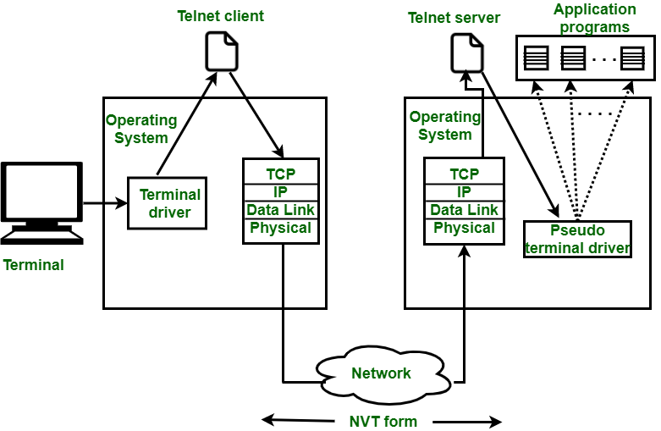

Slide 43
Transmission Control Protocol (TCP)
TCP is a transport layer and acts as the other half of TCP/IP. It arranges packets in order so IP can deliver them. Specifically, TCP numbers individual packets because IP can send packets to their destinations through different routes and get them out of order, so TCP amends this before IP delivers the packets.
TCP also detects errors in the sending process -- including if any packets are missing based on TCP's numbered system -- and requires IP to retransmit those packets before IP delivers the data to its destination. Through this process, the TCP/IP suite controls communication across the internet.

Slide 44
User Datagram Protocol (UDP)
UDP is an alternative to TCP and also works with IP to transmit time-sensitive data. UDP enables low-latency data transmissions between internet applications, making it ideal for VoIP or other audio and video requirements.
Unlike TCP, UDP doesn't wait for all packets to arrive or organize the packets. Instead, UDP transmits all packets even if some haven't arrived.
UDP solely transmits packets, while TCP transmits, organizes and ensures the packets arrive. While UDP works more quickly than TCP, it's also less reliable

Slide 45
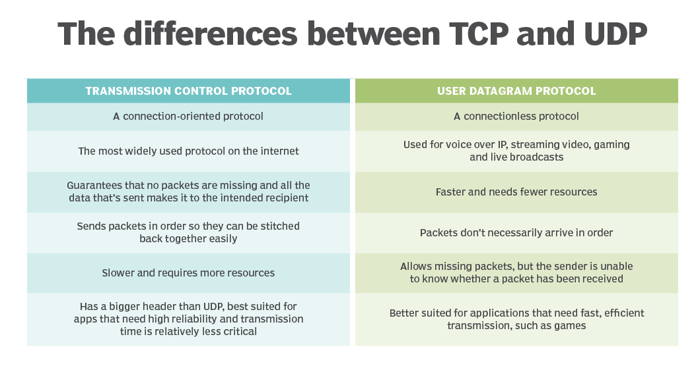

Slide 46
Thank You !!!

